Slide 1

G2M Insight For Cab Investment Firm
Exploratory Data Analysis
LISUM02
06th August 2021
By,
Joseph Antony

Slide 2

Agenda
Executive Summary
Problem Statement
Methodology
Tools Used
Data Preparation
EDA
Hypothesis Results
Forecast
Conclusion

Slide 3

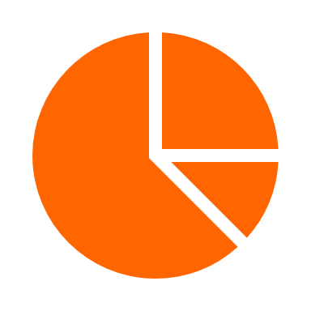


Executive Summary
This report was commissioned to summarize my findings to the client, XYZ company, for the best Cab company to invest in.
This report focuses on two Cab companies - Yellow Cab and Pink Cab.
An extensive Exploratory Data Analysis supported with Hypothesis Testing and Forecasting methodologies were utilized for this study.
Recommendation:
According to the data and two-year forecasts, Yellow Cab has been identified to perform better in terms of:
High daily number of trips on any given day
Higher Market share on most Cities
Better Customer Retention
Higher Profitability

Slide 4
Problem Statement
The Client
XYZ is a private firm in US. Due to remarkable growth in the Cab Industry in last few years and multiple key players in the market, XYZ is planning to invest in Cab industry and as per their Go-to-Market (G2M) strategy, they want to understand the market before taking final decision.
XYZ has provided multiple data sets that contains information on two cab companies. Each data set provided represents different aspects of the customer profile. XYZ is interested in using the actionable insights obtained to help them identify the right company to make their investment.

Slide 5



Methodology
Exploratory Data Analysis (EDA)
Hypothesis Testing
Forecasting

Slide 6


Tools Used
Tableau
Python

Slide 7
Data Preparation
Four data sets that contains information on Two cab companies had been provided.
Each data set represents different aspects of the customer profile.
Time period of data is from 02nd January 2016 until 31st December 2018.
Master Dataset was created by inner joining:
Cab_Data.csv: Includes details of transaction for both cab companies.
Customer_ID.csv: Mapping table that contains a unique identifier which links the customer’s demographic details.
Transaction_ID.csv: Mapping table that contains transaction to customer mapping and payment mode.
The fourth Dataset, City.csv has been left out as it does not provide information about daily trips for both Cab companies.
Schema of Master Dataset

Slide 8

EDA Key Insights

Slide 9
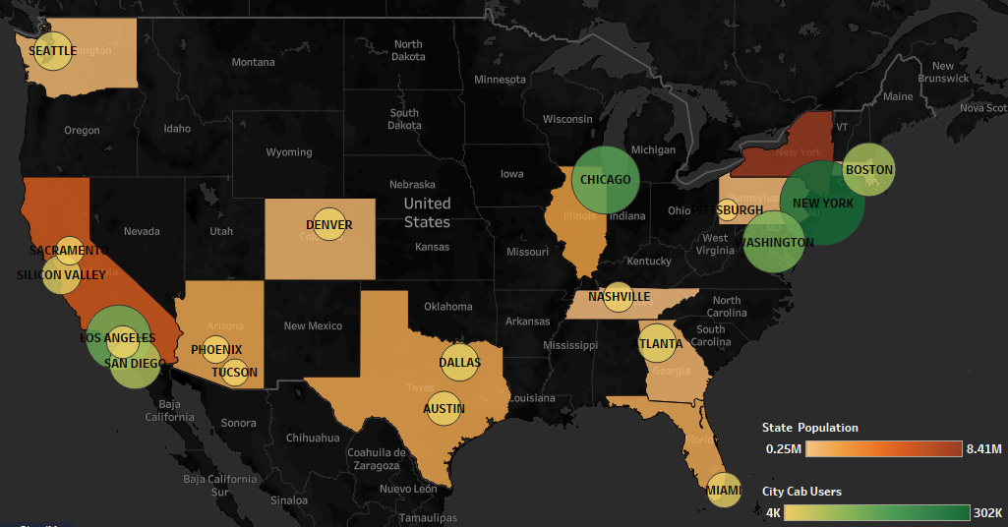
Population and Cab Users

Slide 10
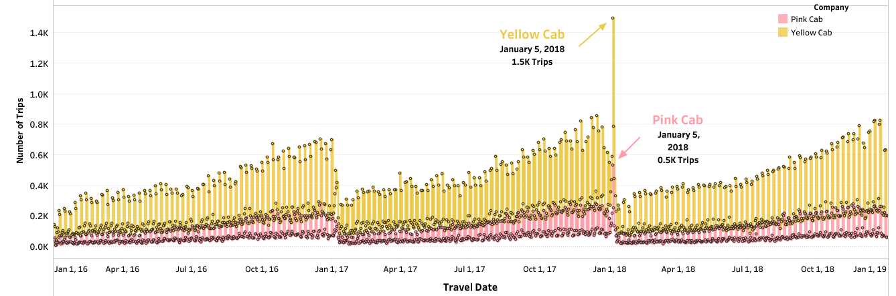
Daily Trips (2016 - 2018)
Same trip pattern for both companies.
Yellow Cab has highest trips every single day.
Jan 5th, 2018, saw the highest number of trips for both cab companies.
Beginning of every year, the trips are very low.
Conversely, at the end of the year, trips are very high.

Slide 11
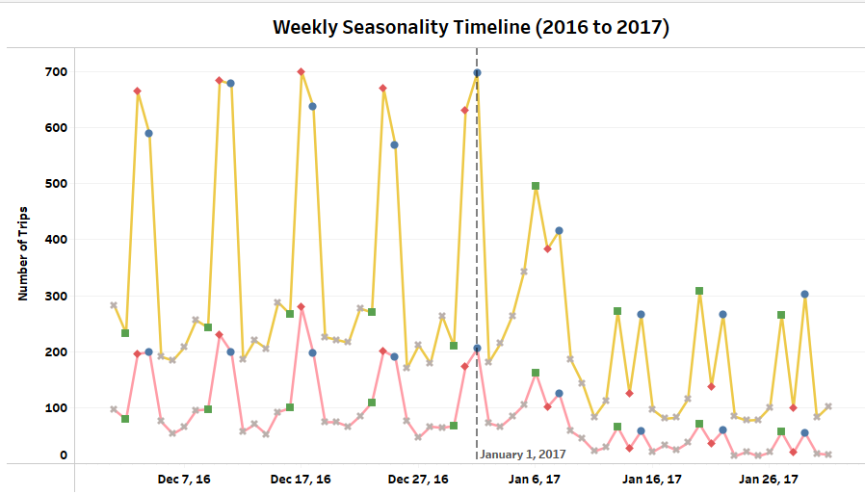
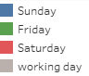

Weekly Seasonality (2016 - 2017)
Low trips on Friday, and higher trips on Saturday and Sunday in 2016.
Pattern changes in 2017, where higher trips on Friday, then lowers on Saturday and high again on Sunday.

Slide 12
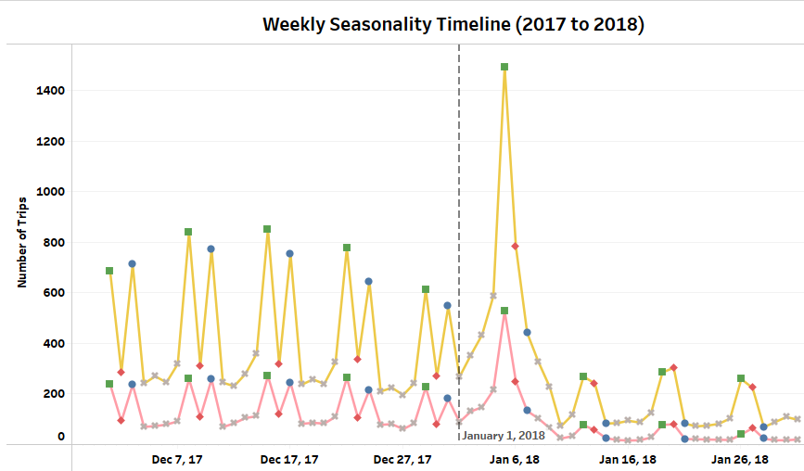
Weekly Seasonality (2017 - 2018)
In 2017, weekly seasonality changes again.
High trips on Friday, then lower trips on Saturday, followed by even lower trips on Sunday

Slide 13
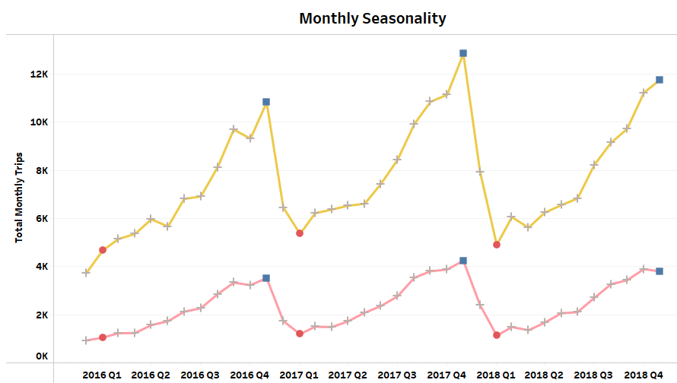
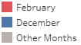
Monthly Seasonality
Highest trips in December
Lowest Trips in February.

Slide 14
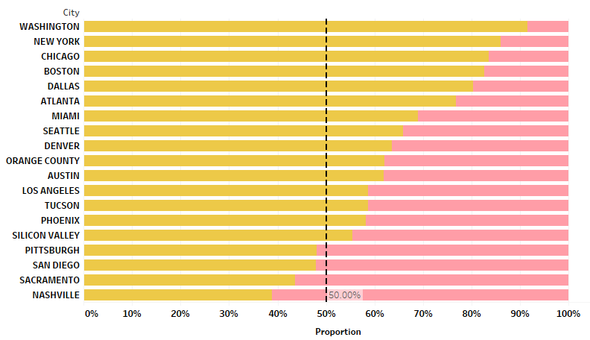
Market Share by City
Market share of Yellow Cab higher across majority of the Cities.
Pink Cab has higher market share on few cities - Nashville, Sacramento, San Diego, Pittsburgh.

Slide 15
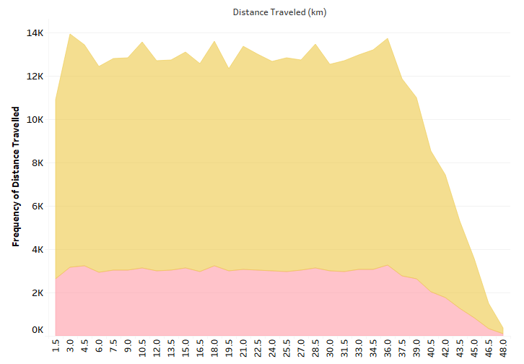
Frequency of Distance Traveled
Distance travelled remain uniform for both Cab companies.
Trips that involves travelling more than 36 km are rarer.

Slide 16
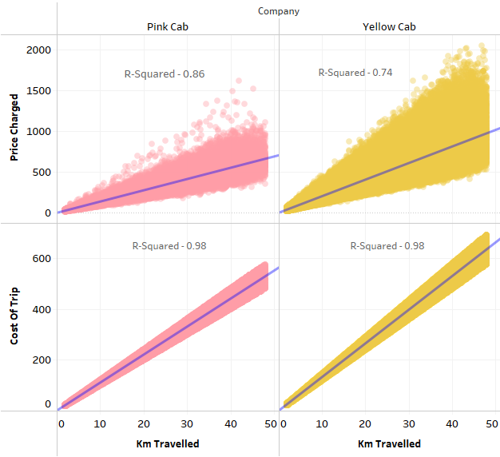
Distance vs Revenue & Expense
High Correlation between Distance traveled and Cab Expenses.
Correlation between Distance and Cab Revenue less compared to Cost of Trip.
Signifies other factors involved in determining prices charged to customers apart from distance traveled.

Slide 17
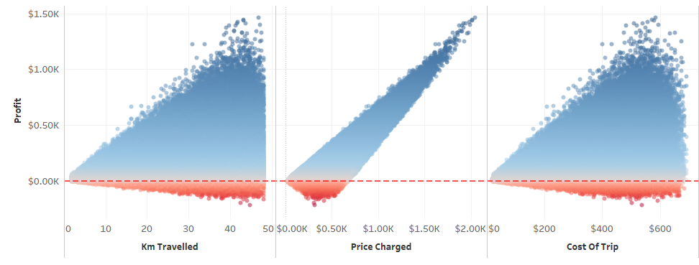
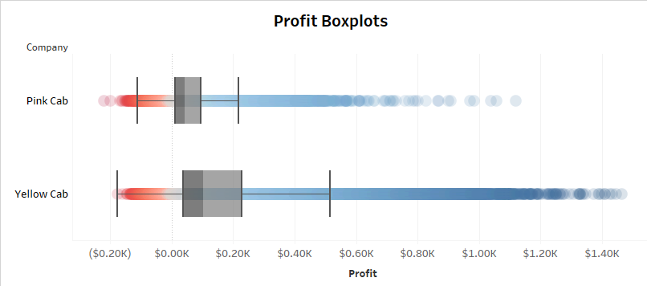
Profit
Profit = Price Charged – Cost of Trip.
Profit more correlated with Price Charged.
Profit varies at low Price charges but varies less as Price Charges increases.
Heteroscedasticity increases with increase in distance traveled. Same pattern for Cost of Trip.
Significant trips did not end in Profit.
Median Profit for Yellow Cab higher than Pink Cab.

Slide 18
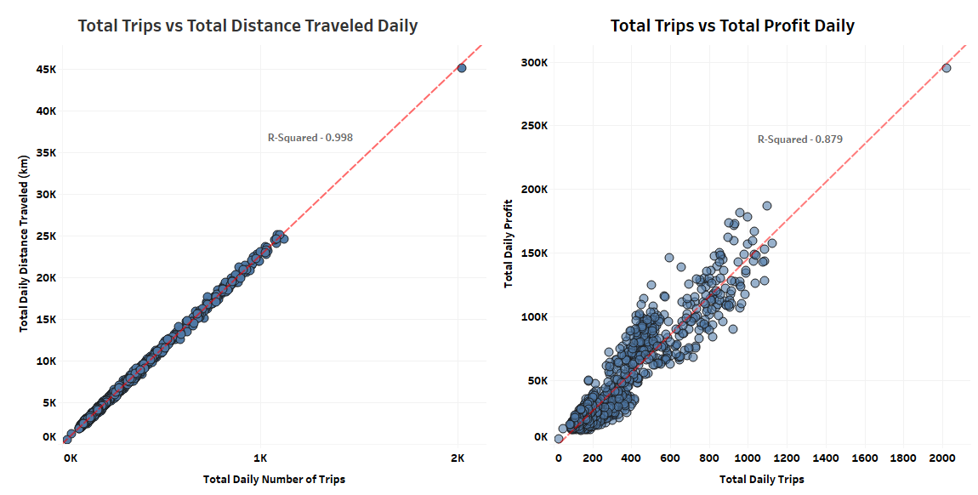
Key Performance Indicator (KPI)
Previous slides show the relations between Profit and Cab’s Fares and Expenses.
Both Cab fares and Expenses depend on distance traveled.
There is a perfect correlation between daily total trips and Daily total Distance traveled.
Moreover, daily total trips also have a strong correlation with total daily profit.
Therefore, the number of trips a cab company travels in a day can determine the company’s financial performance.

Slide 19
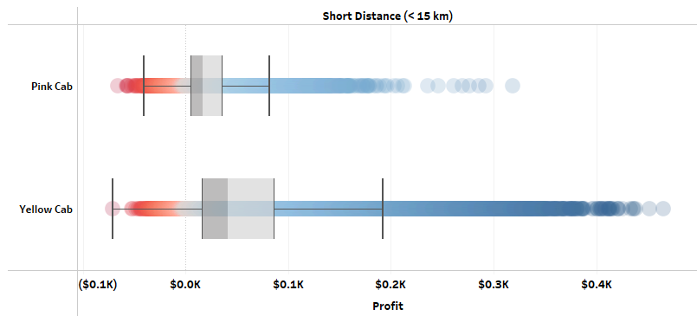
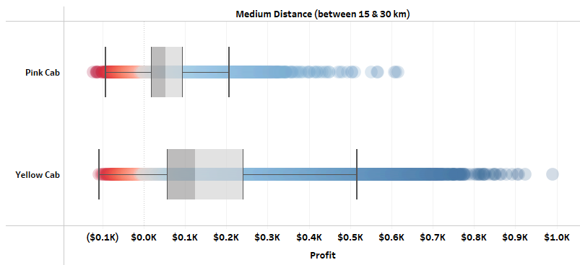
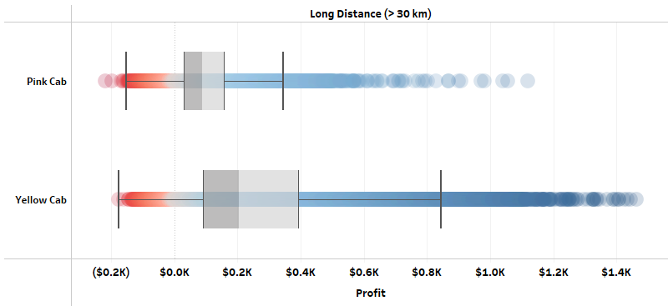
Profit by Trip Type
Trips has been split into three categories based on distance.
Across all kinds of trips, Yellow Cab makes higher median Profit compared to Pink Cab.

Slide 20
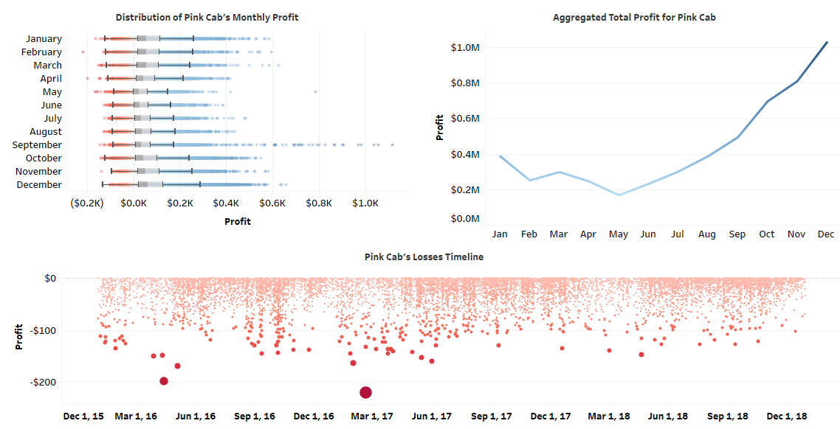
Pink Cab – Profit Analysis
Month likely associated with Profit.
Median Profit lowest in May for Pink Cab and highest during December.
Higher Profit outliers for month of September.
Total Profit highest in December (2016 to 2018).
Trip that ended in highest loss of $220 made in February 2017, followed by $199 in April 2016.

Slide 21
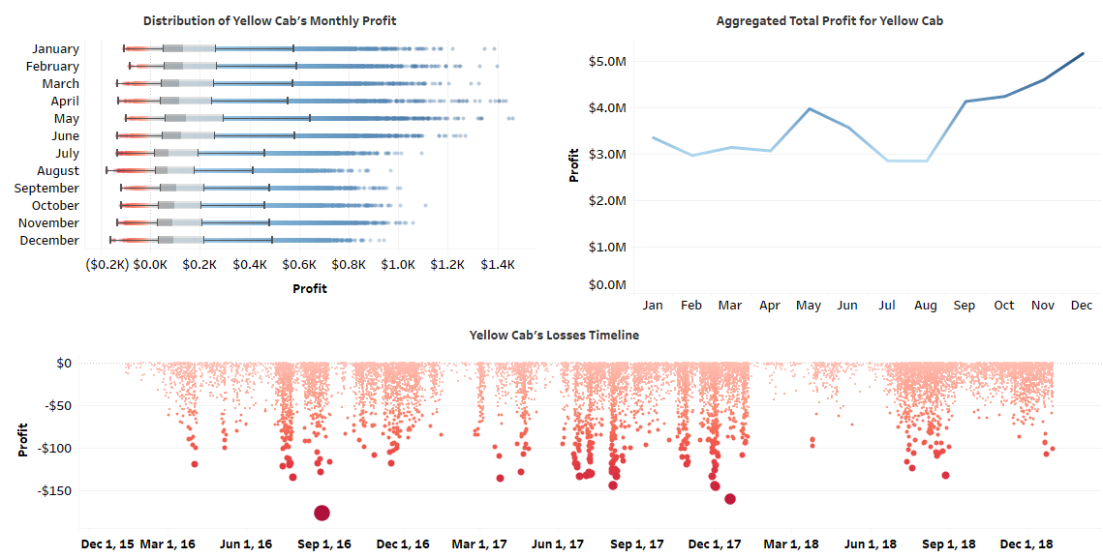
Yellow Cab – Profit Analysis
Yellow Cab profit significantly higher across all months compared to its rival.
Median Profit lowest during July and August.
Highest Total Profit in December (2016 to 2018),
Trip that ended in high loss of $177 made in August 2016, followed by $166 on December 2017.

Slide 22
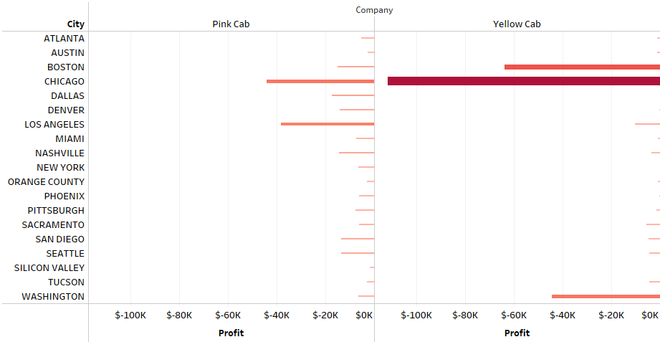
Loses by City
Yellow Cab makes highest total loses in Chicago, followed by Boston and Washington.
Pink Cab makes highest total loses in Chicago and Los Angeles.

Slide 23
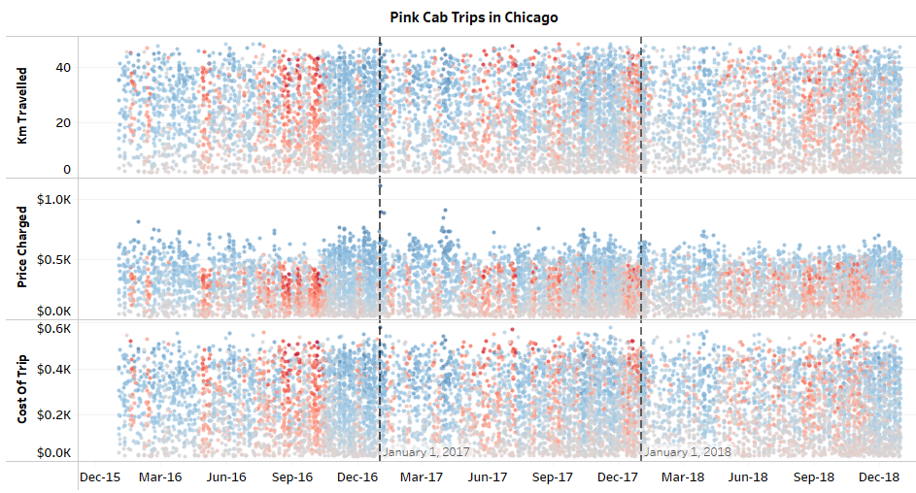
Analyzing Chicago Non-Profitable Trips – Pink Cab
Red bands represents trips that did not make profit (Loss).
Cab expenses was higher than Cab revenue for non-profitable trips.
In 2016, consistent non-profitable trips made during month of April, July, August, September, October.
In 2017 and 2018, although several non-profitable trips were made across many months, they are less in comparison with the year 2016.

Slide 24
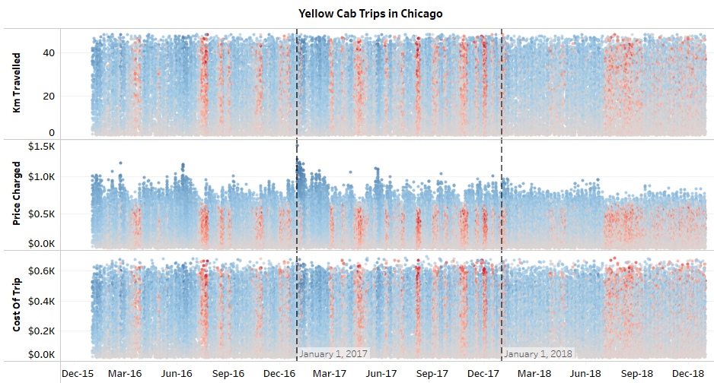
Analyzing Chicago Non-Profitable Trips – Yellow Cab
For Yellow Cab, July and August has highest number of non-profitable trips across all years.
2017 saw highest number of non-profitable trips across many months and 2018 saw the lowest number of non-profitable trips compared to other years.

Slide 25
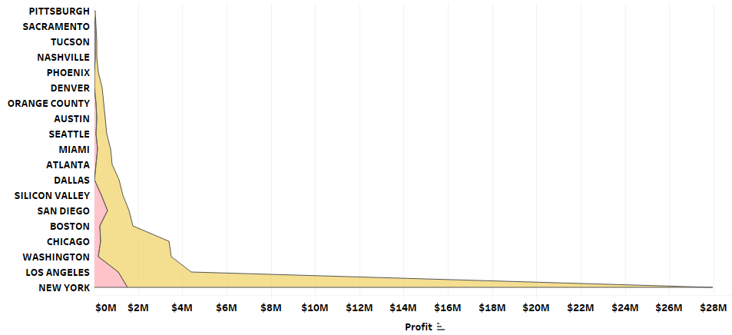
Profit by City (2016 to 2018)
Yellow Cab’s total Profit outperforms Pink Cab across all cities.
Highest total profit for both Cab companies is in New York.

Slide 26
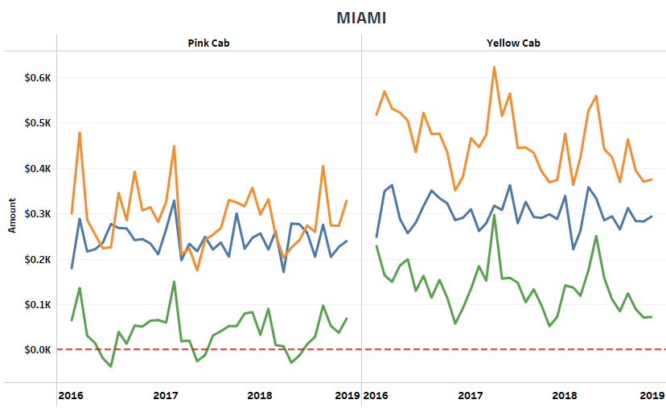
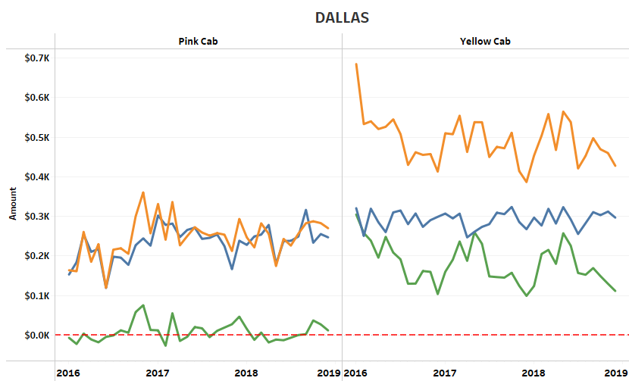
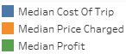
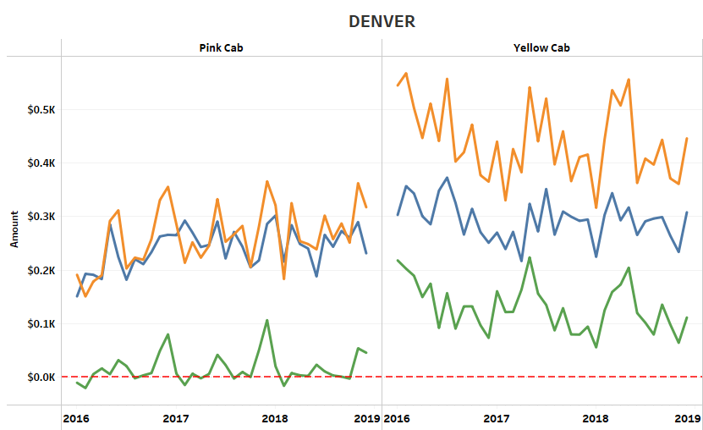
Monthly Timeline of Trips (1)
The plots illustrates median monthly prices from 2016 to 2018 across selected cities.
In general, Yellow Cab’s expenses is relatively higher than Pink Cab’s.
In the above cities, Pink Cab’s median profits for some months has been consistently in loss.
Yellow Cab’s Profit is comparatively much higher than Pink Cab.

Slide 27
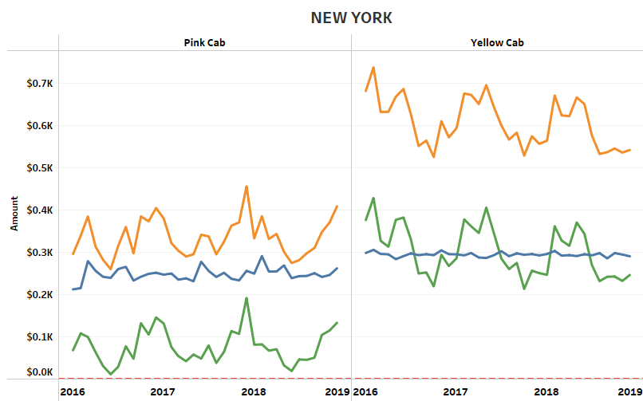
Monthly Timeline of Trips (2)
In New York City, although the Cab expense is similar in other cities, Yellow Cab charges significantly higher Cab Fares.
Hence, Yellow Cab makes the highest profit in New York compared to any other city.
Comparatively, Pink Cab charges very low Cab fares to its customers.

Slide 28
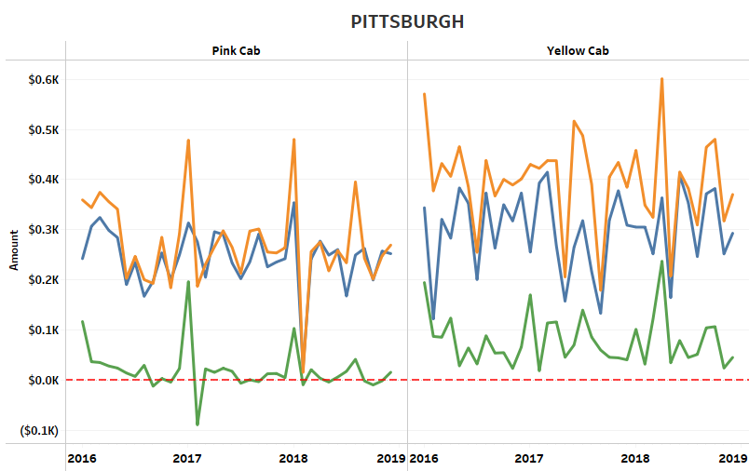
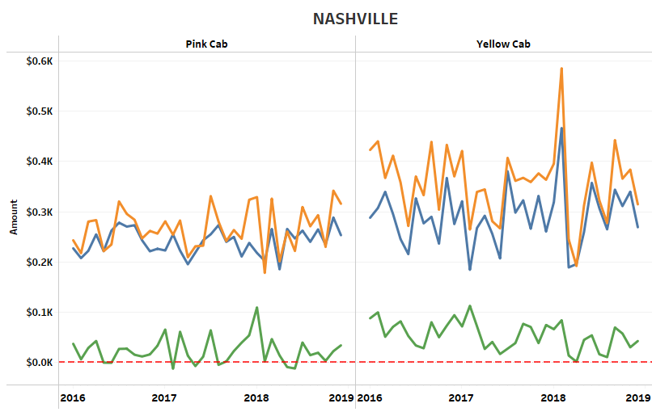
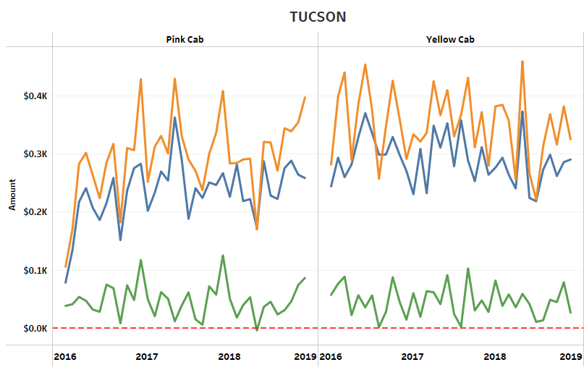
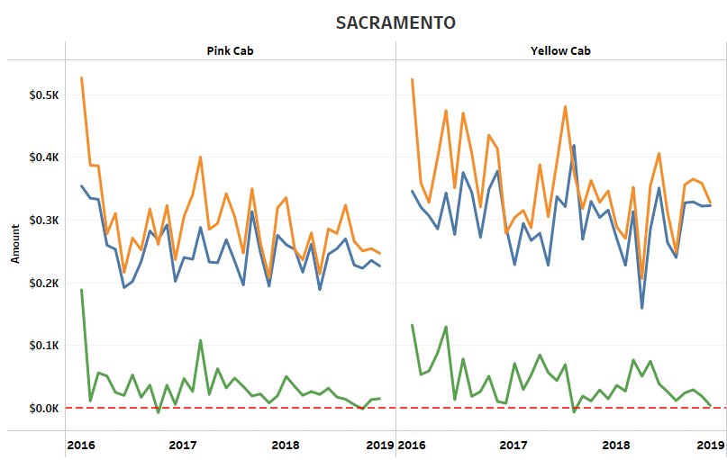
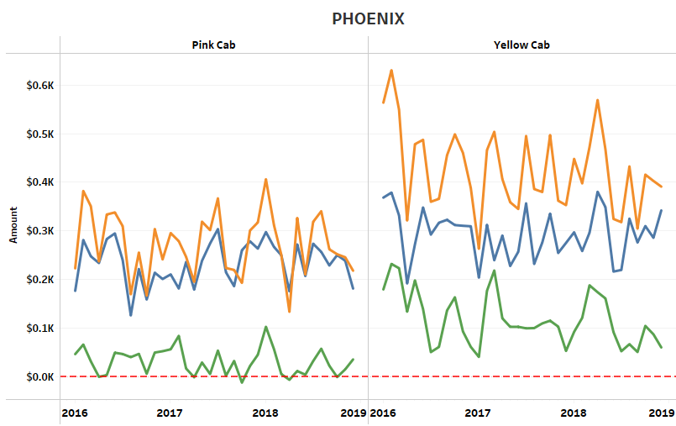
Monthly Timeline of Trips (3)
In some cities, both companies seems to have non-seasonal fluctuating cab fares and expenses.

Slide 29
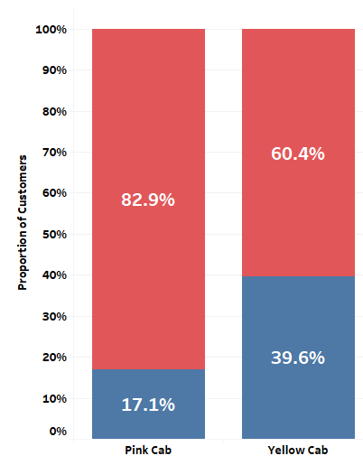
Loyal Customers
The plots illustrates the proportion of most loyal customer’s who has used a Cab service at least five times.
Overall, Yellow Cab has the highest proportion of loyal customer’s by about 40%.

Slide 30
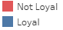
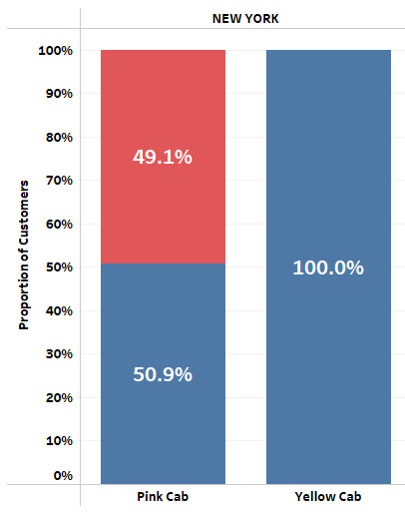
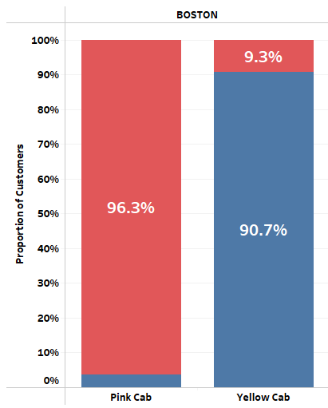
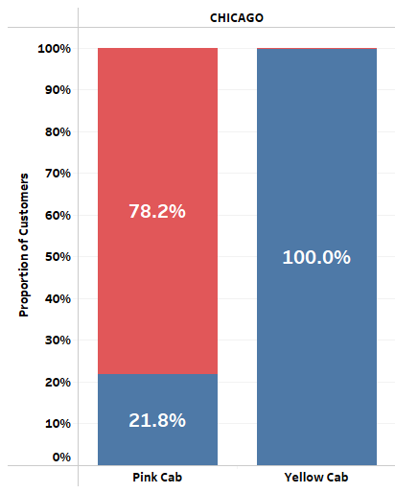
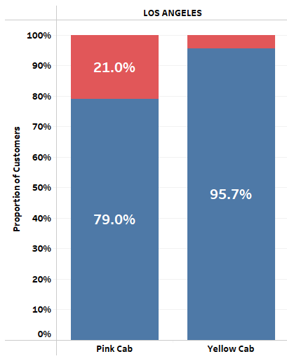
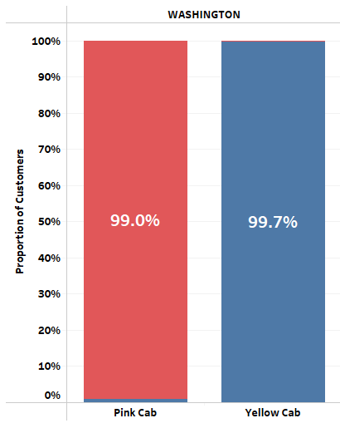
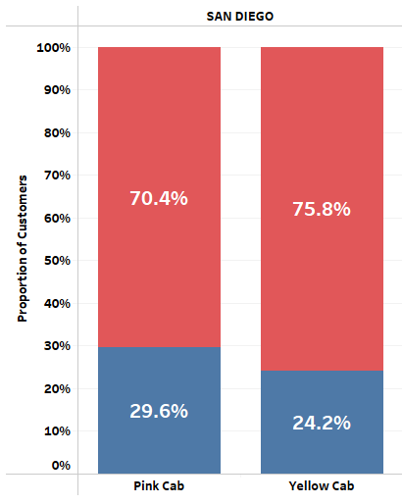
Loyal Customers by City
Yellow Cab has the highest loyal customers in New York, Boston, Chicago, Los Angeles and Washington.
Although lower than its rival, Pink Cab has significant loyal customers in Los Angeles, followed by New York.
Only in San Diego, Pink Cab has comparatively higher loyal customers compared to its rival, at about 30%.

Slide 31

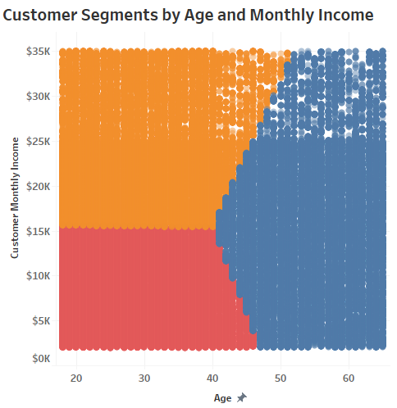
Customer Segments
From the data, three segments of customers has been identified based on Age and monthly income:
Young & Low Income: Customers below age 40 and earning lower than $15K a month.
Young & High Income: Customers below age 40 and earning higher than $15K a month.
Senior: Age above 40 and salary varies from $2K to $35K a month.

Slide 32
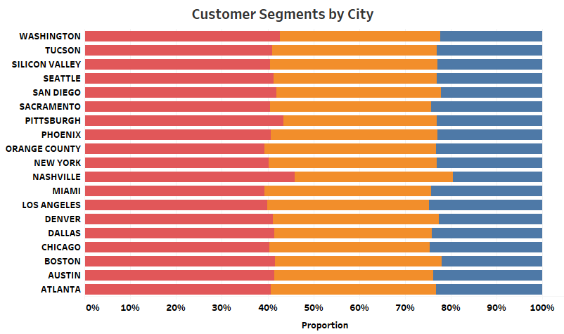
Customer Segments by City
Proportion of customer segments approximately the same across all cities.
Noticeably, Nashville and Pittsburgh have higher proportion of customers who are of young and low-income segment.

Slide 33
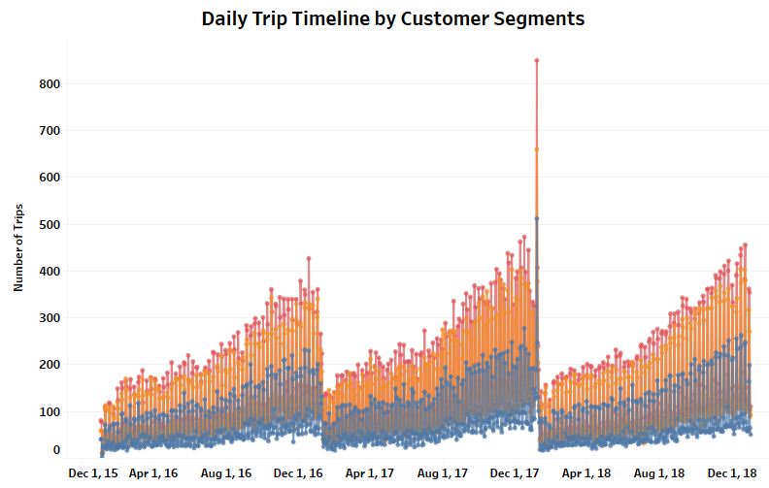
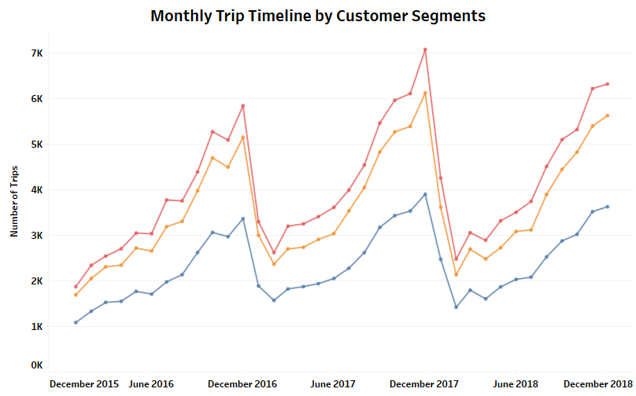
Customer Segments Trips
For both Cab companies, customers who travels the most both daily and monthly are from the
Young and low-income segment, followed by
Young and high-income segment.

Slide 34
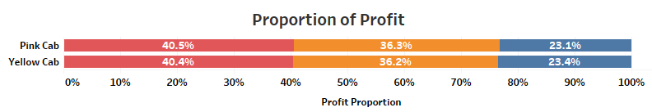
Profit by Customer Segments
The proportion of profit from customer segments are similar for both Cab companies.
Young and Lower income customers contribute the highest profit for both Cab companies, followed closely by Young & high-income customers.
This is inline with earlier observations, where the higher the number of trips, the higher is the profit.

Slide 35
Hypothesis 1: Is there any association between Profit being at a loss and the type of trip?

Slide 36
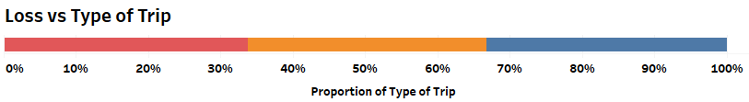
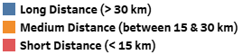
H0: There is no association between Loss and type of trip.
H1: There is an association between loss and type of trip.
Test Utilized : Chi-squared test
Alpha: 0.05
P-Value: 1.0
Verdict: If the Null Hypothesis is true, the probability that the observed number of trips is the same as the expected number of trips from a randomly sampled data is 100%. Therefore, as the P-value is higher than the alpha value, we fail to reject the null hypothesis. There is no association between Loss and type of trip.

Slide 37
Hypothesis 2: Is there any association between Profit and the type of trip?

Slide 38
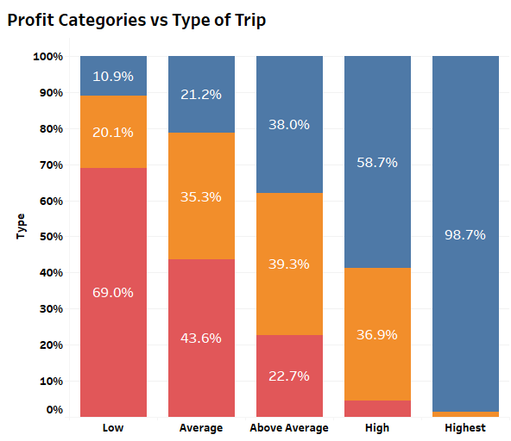
Profit Levels:
Low Profit: < $30
Average Profit: Between $30 and $85
Above Average Profit: Between $85 and $200
High Profit: $200 and $800
Highest Profit: > $800
H0: There is no association between Profit and type of trip.
H1: There is an association between Profit and type of trip.
Test Utilized : Chi-squared test
Alpha: 0.05
P-Value: 0.0
Verdict: If the Null Hypothesis is true, the probability that the observed number of type of trips is the same as the expected number of type of trips for each profit category from a randomly sampled data is 0%. Therefore, as the P-value is lower than the alpha value, we reject the null hypothesis. There is association between Profit and type of trip.

Slide 39
Hypothesis 3: Is there any association between Profit and Customer income level?

Slide 40
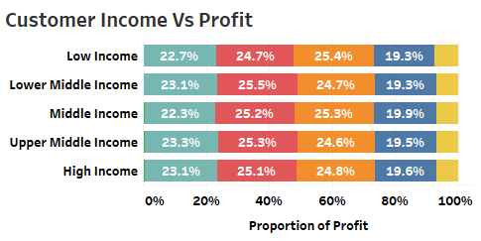

Monthly Income Levels:
Low Income: < $2670
Lower Middle Income: Between $2670 and $4451
Middle Income: Between $ 4451 and $8903
Upper Middle Income : $ 8903 and $20,030
High Income : > $ 20,030
H0: There is no association between Customer Income and Profit.
H1: There is an association between Customer Income and Profit.
Test Utilized : Chi-squared test
Alpha: 0.05
P-Value: 0.0
Verdict: P-value is statistically significant since P-value is lower than the alpha. Therefore, we can reject the null hypothesis. There is an association between Profit and Customer income level.

Slide 41
Hypothesis 4: Is there an association between City and Profit?

Slide 42

H0: There is no association between City and Profit.
H1: There is an association between City and Profit.
Test Utilized : Chi-squared test
Alpha: 0.05
P-Value: 0.0
Verdict: P-value is statistically significant since P-value is lower than the alpha. Therefore, we can reject the null hypothesis. There is an association between Profit and City.

Slide 43
Hypothesis 5: Does Profit vary by Month?

Slide 44

H0: No difference in median profit across months
H1: At least one month has different median profit from other months.
Test Utilized : Kruskal-Wallis H-test
Alpha: 0.05
P-Value: 0.0
Verdict: If the null hypothesis is true, the probability of obtaining median profit such as shown here will be 0%. Since the P-value is lower than the alpha, we reject the null hypothesis in favor of the alternative hypothesis. Median profit do change at least for one month.

Slide 45
Hypothesis 6.1: Does Pink Cab charge its customer differently based on gender?

Slide 46

H0: No difference in median price charged among gender
H1: There is a difference in median price charged among gender.
Test Utilized : Mood’s median test
Alpha: 0.05
P-Value: 0.278
Verdict: If the null hypothesis is true, the probability of obtaining median price charged such as shown here will be 27.8%. Since the P-value is higher than the alpha, we fail to reject the null hypothesis in favor of the alternative hypothesis. Median price charged remains the same for Pink Cab’s customers regardless of gender.

Slide 47
Hypothesis 6.2: Does Yellow Cab charge its customer differently based on gender?

Slide 48

H0: No difference in median price charged among gender
H1: There is a difference in median price charged among gender.
Test Utilized : Mood’s median test
Alpha: 0.05
P-Value: 0.0
Verdict: If the null hypothesis is true, the probability of obtaining median price charged such as shown here will be 0%. Since the P-value is lower than the alpha, we reject the null hypothesis in favor of the alternative hypothesis. Median price charged is different for Yellow Cab’s customers based on gender.

Slide 49
Hypothesis 7: Is there an association between Customer Income Level and Type of Distance traveled?

Slide 50

H0: There is no association between Customer Income and Distance Traveled.
H1: There is an association between Customer Income and Distance Traveled.
Test Utilized : Chi-squared test
Alpha: 0.05
P-Value: 0.427
Verdict: P-value is statistically insignificant since P-value is higher than the alpha. Therefore, we cannot reject the null hypothesis. There is no association between Customer Income and Distance Traveled.

Slide 51
Hypothesis 8: Does Public Holidays affect daily number of trips?

Slide 52

H0: No difference in median daily trips during both types of days.
H1: There is a difference in median daily trips during both types of days.
Test Utilized : Mood’s median test
Alpha: 0.05
P-Value: 0.403
Verdict: If the null hypothesis is true, the probability of obtaining the results of median daily trips such as shown here is 40.3%. Since the P-value is higher than the alpha, we fail to reject the null hypothesis in favor of the alternative hypothesis. There is no significant difference in median trips on both types of days.

Slide 53

Trips during Public Holidays
The lowest trips during public holidays for all three years were on Martin Luther King Jr. Day and Washington’s Birthday.
During Public Holidays, customers travel the most during Labor Day Weekend, followed by Christmas Eve and New Year’s Eve.
In 2016, there were almost no trips on New Year’s Day according to the data. But New Year’s Day in 2017 is observed to have a high spike in trips. In 2018, trips on this day has reduced significantly.

Slide 54
Forecasting Forecasting Daily Number of Trips for the Next Two Years

Slide 55

Forecasting Strategy
Goal: Forecast Individual Company’s Daily Number of Trips
Model Used: Facebook Prophet
Evaluation Metric: Root Mean Squared Error (RMSE)
Problem Type: Supervised Learning
Steps Involved:
Initially decomposing Daily Trip Time Series.
Analyze Auto Correlation and Partial-Auto Correlation Plots.
Create ‘n’ lags as independent variables.
Split the time series into Train and Test sets. Test set will be for a period of last 90 days.
Train Prophet Model using only Train set.
Evaluate model performance by comparing predictions with Test set.
Train on the whole dataset and forecast daily trips for next two years.
Compare forecasts of both Cab companies.

Slide 56


Daily Trips Time Series Decomposition
Yellow Cab
Pink Cab
The plots illustrates a breakdown of Daly trip time series into trend, seasonal and residuals (error) components.
Multiplicative model used due non-constant monthly and yearly seasonality.
Trend: Noticeable upward month-wise trend but the annual trend seems constant for both companies.
Seasonality: Constant seasonality across all weeks.
Residuals: No noticeable pattern.

Slide 57


ACF & PACF
Yellow Cab
Pink Cab
Both time series were differenced one time to make the series stationary.
High auto correlation with the 7th lag, illustrating that the number of trips at present is correlated with the number of trips within the past week (7 days).

Slide 58

Model Training
Created lags as independent variables by differencing 54 days.
Additionally, extracted day, month, week, etc. as additional independent variables.
Data split into train (01/01/2016 to 14/10/2018) and test (15/10/2018 to 31/12/2018) sets.
Training Dataset

Slide 59



Model Evaluation – Pink Cab
RMSE = 17.62 days
Mean Test trips = 79.69 trips
Model Accuracy = 88.36%
The predicted line approximately follows the same pattern as the test set. The model seems to over predict trips on all days.
Forecasting for the next two years seems to illustrate same trend as before.

Slide 60



Model Evaluation – Yellow Cab
RMSE = 32.5 trips
Mean Test trips = 256.67 trips
Model Accuracy = 93.42%
The predicted line nearly follows the same pattern as the test set, much better than Pink Cab’s forecasts. The model also seems to have a better accuracy.
Forecasting for the next two years seems to illustrate same trend as before.

Slide 61

Forecast Comparison
The plots depicts the forecasts made by the model for the next two years (2019 to 2020).
The confidence intervals of Yellow Cabs are wider compared to Pink Cabs.
When comparing both forecasts side by side, we can see Yellow Cab company is projected to still lead in daily trips compared to its rival.

Slide 62
Conclusion
To conclude, based on the extensive EDA, hypothesis testing, and forecasting done on the datasets provided, I highly recommend XYZ to invest in Yellow Cab for the following reasons:
Higher market share across all cities, especially in New York.
Higher number of trips every single day.
Despite losses during specific months, Yellow Cab still outperforms Profit wise.
Higher customer loyalty.
Forecasts for next two years shows Yellow Cab will still outperform its rival every single day.

Slide 63

Thank You!

